Slide 1


PRODUCT
TEARDOWN
By: Saransh Jindal

Slide 2

ABOUT COMPANY
Decentro is a full-stack API banking platform that helps businesses launch financial products 10X faster and reduce expenditure by 80%.
Reduces friction for Fintechs, Neobanks, Lenders, Gig-Economy Players in their flow of money.
Extensively leverages UPI network to facilitate it’s to and fro flow.

Slide 3








WHY CHOOSE DECENTRO?
CLIENTS
Decentro enables businesses to choose the right modules for their businesses, integrate their APIs & SDKs to ease up their financial workflow and focus on product building.
In this highly regulated industry, Decentro takes care of all compliance and moulds the products accordingly.
YC-backed ;)
and 800+ more

Slide 4








VERTICALS
Multi-Collect: Collect funds from individuals or businesses and reconcile them directly from Virtual Accounts.
Ledgers: Manage all your transactions and balances on a single platform.
Recurring Payments: Collect recurring payments from users without manual follow-ups.
Instant Payouts: Disburse payments to consumers and users directly from your dashboard via your choice of method.
Escrow Accounts: Manage All Your Escrow Needs In One Place.
UPI Collections: Empower your platform with the power of UPI to collect payments and provide instant confirmation.

Slide 5






VERTICALS
KYC & Onboarding: Confirm and validate individuals or businesses by accessing government- approved documents.
Lending: Launch your white- labelled lending product on your platform today.
Bytes: Pull secure data of user or entity with a single API hit.
Hyperstreams: Build your Financial product using a pre- built sequence of APIs and SDKs.

Slide 6

HOW DECENTRO HELPED ZOOZLE SIMPLIFY COLLECTIONS & PAYOUTS?
Zoozle is an e-commerce platform for companies to find leads & make purchases from verified businesses.
Zoozle helps a business to gather leads from everyday purchases. Be it anything- a laptop or executive chair.
Zoozle helps businesses with lead generation, logistics, supplier credit & financing, and payment management, etc.
Naturally, Zoozle requires a secure payment collection, and cashflow management environment to ensure zero bad debts via escrow.
Decentro’s product suite helped Zoozle streamline its collection processes and payouts and verify the identities of registered businesses. But How???

Slide 7

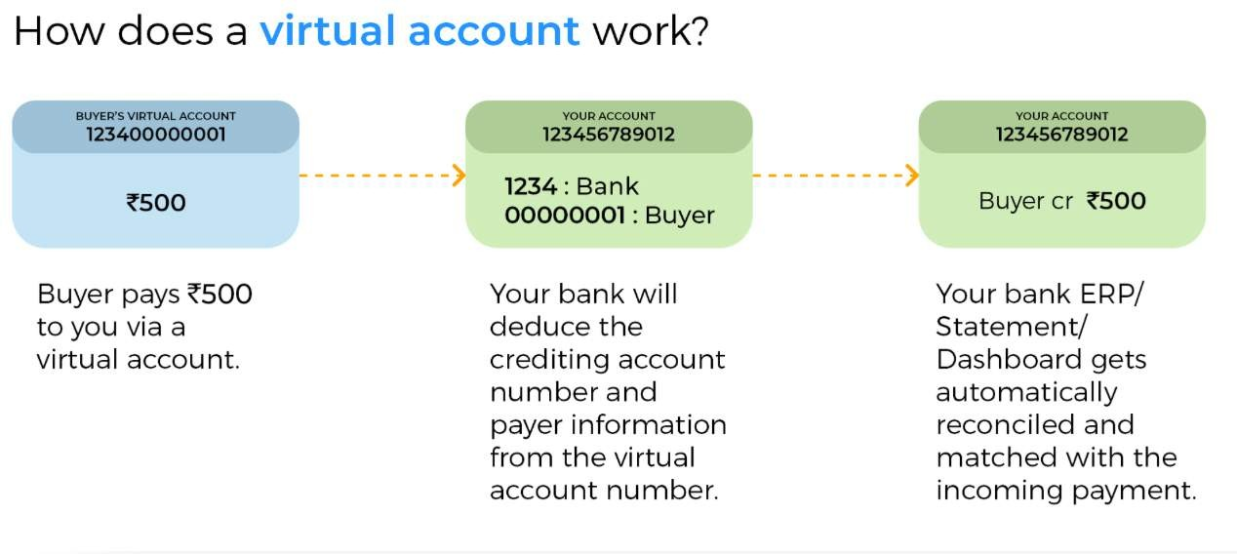
VIRTUAL BANKING INFRASTRUCTURE
With virtual banking infrastructure, Zoozle was able to launch payment capabilities on its platform within a week.
Each buyer had a virtual account created which were set up on top of Zoozle’s business account.
Any ledger entry or transaction was updated on Zoozle’s dashboard & Accounting ERP, making it effortless to reconcile payments.

Slide 8
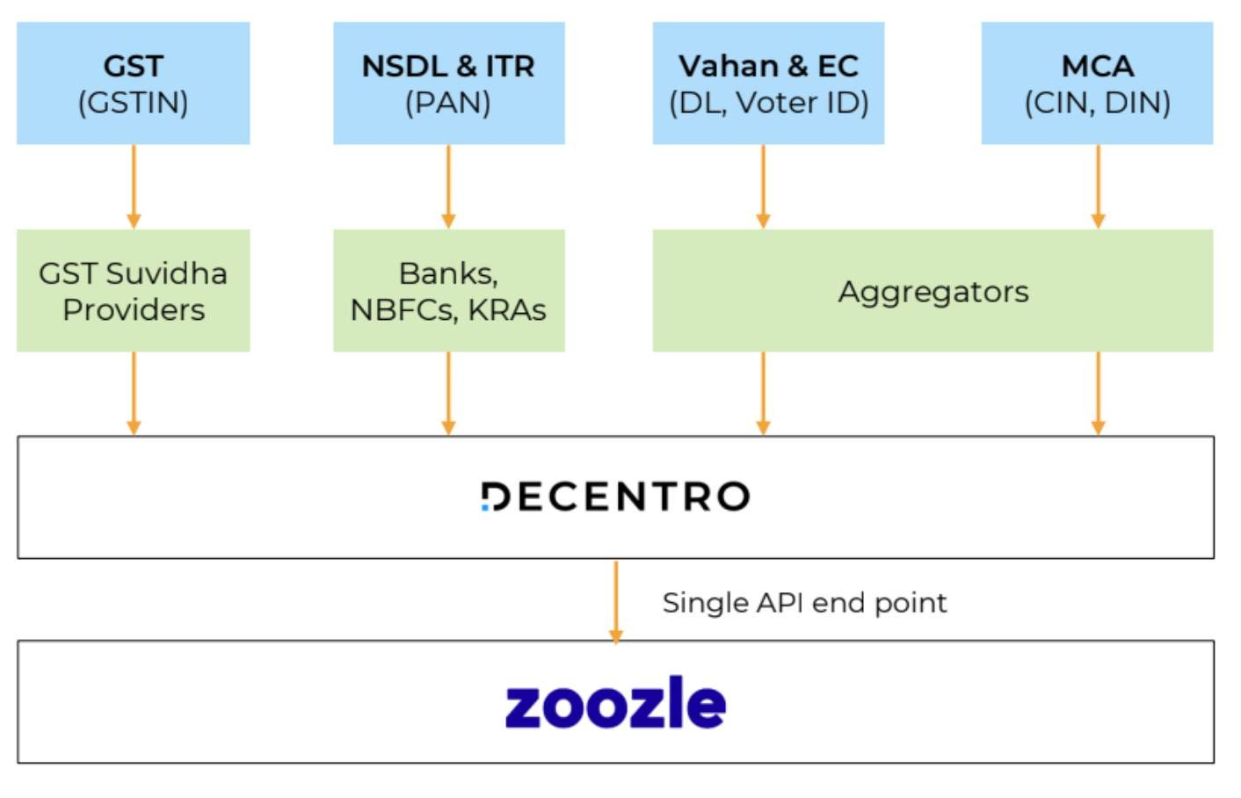
KYC SUITE
Decentro’s KYC suite enabled Zoozle to run comprehensive identification checks on sellers using multiple Government- issued IDs.
Instant KYC means faster seller onboarding and lesser hassle of record keeping.

Slide 9
BUSINESS BANKING
Zoozle is now looking to offer banking to the companies registered on the platform.
By linking business accounts to the platform, businesses can perform a variety of banking functions such as:
Fetching bank statements
Adding beneficiaries without any cooling periods Initiate payments within the platform
Enable virtual accounts for payment reconciliation

Slide 10

OUTCOMES?
Zoozle is able to onboard more than 1000+ retailers a month using Decentro’s Digilocker APIs and multiple KYC stacks like GST, PAN, etc.
Zoozle’s go-to-market timelines were reduced by 50%.
Instant settlements were made possible at half the costs for sellers. Real-time and automated payment reconciliation removed additional headaches from the equation.
Anytime cash withdrawal from the virtual account to the seller’s bank account gave the sellers absolute control over their funds.

Slide 11

POTENTIAL IMPROVEMENTS
Invoicing
Clients can create & customize white-
labelled invoices generated by Decentro to fasten up the whole checkout process.
Licensing
Trusted clients & partners can be benefitted
from Decentro’s RBI license and Decentro’s license can be used to operate instead of getting into the hassle of getting one of their own.
Multicurrency Transactions
Decentro is not dealing with money
exchanges within multiple currencies. A product in this domain can make it a global business.

Slide 12

THE USP!!!
Decentro leveraged the UPI network to facilitate Payout,
Collections, Mandates, etc thereby eliminating foreign competition in India.
Acquired Neowise Money to extend Lending vertical towards Debt Collection.
Escrow accounts are added, which can be used for fraud
prevention in marketplaces, invoice financing, P2P lending etc.
Seamless and automated payouts to multiple vendors and collection from multiple individuals.

Slide 13

CONCLUSION
Decentro has positioned itself smartly in the Fintech industry which is expected to grow to $150B by 2025 with some of the best offerings and eliminating the outside competition to an extent.
One of the best products are offered to businesses thereby playing on “Switching Costs” and not losing partnerships with existing clients.

Slide 14

FOUND INTERESTING? LET'S CONNECT?
By: Saransh Jindal

